Slide 1

Tech Deep Dive Cohort 6
Cloud Computing with Azure Track

Slide 2

Automating Infrastructure Deployment Using Infrastructure as Code (Iac)
TEAM CHARIS PROJECT WALKTHROUGH
27th June, 2025

Slide 3
Problem Statement
Manual infrastructure provisioning which causes:
Errors
Delays
Inconsistent and insecure environments
Less repeatable Infrastructure set up

Slide 4
Solution Overview
Automated Azure infrastructure deployment with:
Bicep & ARM templates
Azure AD PIM
VNets, NSGs, Subnets
VMs & Storage
Azure Policy & Monitor

Slide 5
Key Tools
Bicep
VS Code
Azure CLI
Azure Monitor
Azure Policy
GitHub

Slide 6
Benefits/Business Value
Faster Delivery Accelerate rapid, repeatable deployments.
Consistency & Quality Eliminate errors with Infrastructure-as-Code for identical environments.
Cost Control Tagging & policy help track spend and enforce cost-saving standards.
Security & Compliance Automate secure configurations and maintain audit trails.
Developer Productivity Enable devs with self-service environments — focus on building, not setup.

Slide 7
Design And Architecture
🔐 Tenancy
The deployment operates under a Single Azure Active Directory (Azure AD) Tenant, enabling centralized identity, access control, and security policy management. This simplifies governance and ensures consistency across all environments.
🗂️ Management Structure
An Azure Management Group hierarchy organizes resources by environment and project team, allowing clear delegation of access, policies, and billing.
Architecture
Includes automated provisioning of virtual networks, VMs, storage, security policies, and monitoring resources.

Slide 8
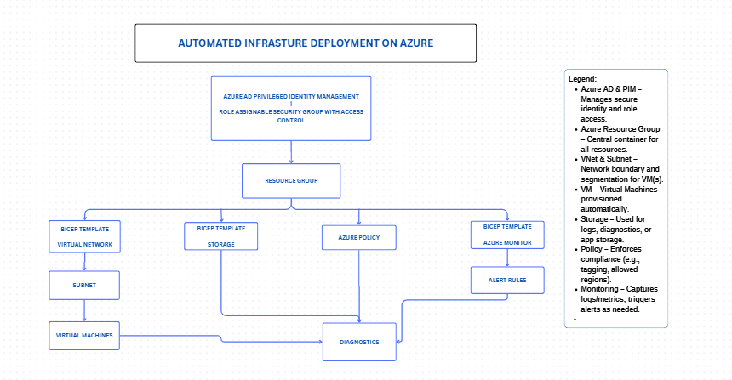
Architectural Design

Slide 9
Automated VM & Secure Network Deployment
Secure Storage Provisioning
Role-based Access with PIM
Real-time Alerts with Azure Monitor
Enforced Governance Via Azure Policy
All with a single-click deployment
Key Features / Capabilities

Slide 10
User Flow / Experience
Infrastructure as Code (IaC): Every resource—virtual machines, storage, networks—is created using Bicep templates.
User & Role Automation: Automatically creates users and assigns them roles securely using Azure AD PIM.
Centralized Monitoring: All resources are tracked through Azure Monitor and Log Analytics.
Security & Compliance: Azure Policy ensures every deployment meets company rules (e.g., secure storage only).
Single-Click Deployment: A script can deploy everything with one command—no more clicking around.
Ready for CI/CD: Built to connect with GitHub or Azure DevOps pipelines for future automation.

Slide 11
User Flow / Experience
Configure PIM for role-based access
Deploy with IaC – Bicep Templates
Policies enforce compliance
Monitor resources & receive alerts

Slide 12
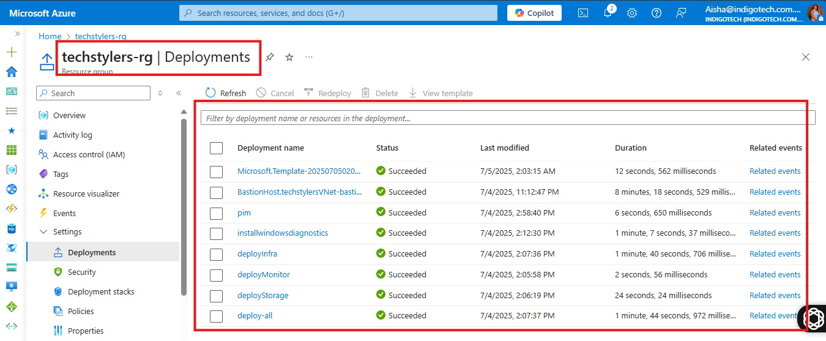
Demo / Walkthrough
Screenshot showing automated deployment speed
Link to Demo: TECHSTYLERS GROUP A project using Azure CLI and Bicep[1].docx

Slide 13
Automated vs Manual
✔️ Over 60% faster deployments
✔️ Reduced manual errors
✔️ Improved compliance and security with automated alerts
✔️ Scalable and Reusable Templates
✔️ Increased confidence
Delays (in hours)
Error-prone
Inconsistent and insecure environment
Less repeatable infrastructure
More overhead Cost

Slide 14
Challenges And Lessons
Challenges
Lessons
Debugging Bicep modules, parametizing templates
License constraints with configuring PIM roles
Encountered errors with Powershell scripting And Microsoft Graph module set up
Parameterization makes templates reusable and adaptable.
Debugging Bicep requires careful attention to resource names and types.
Monitoring setup must align with business-critical metrics.
PIM access controls enhance security but requires user onboarding.

Slide 15
Future Enhancements
Recommendations to consider
Automate
Automate CI/CD with GitHub Actions
Integrate
Integrate Azure Key Vault for secrets
Expand Policy
To include resource locks

Slide 16
Meet The Team
Aishat Oshileye – Project Manager
Rebecca – Identity/Security Lead
Victor Nwoke – VM/Networking Lead
Lucy Obilor/ Oluwatobiloba Aladetuyi – Storage Leads
John Oche – Monitoring Lead
Oladimeji Williams – Documentation Lead
Miracle Clement – Presentation Lead.

Slide 17
Closing / Thank You
The team successfully implemented an automated Azure infrastructure solution. This project improved skills in Bicep, Azure governance, and cloud automation
Thank you for your time!
Q&A.

